Slide 1


Slide 2

Young Professional Internship Program
bbv Software Services AG | Date: 25/07/2025

Slide 3




Presentation on Microsoft Lists Functionalities
bbv Software Services AG | Date: 21/07/2025

Slide 4

Agenda
Introduction
Key Functionalities of Microsoft List
Example data

Slide 5


Introduction
What is Microsoft Lists?

Slide 6
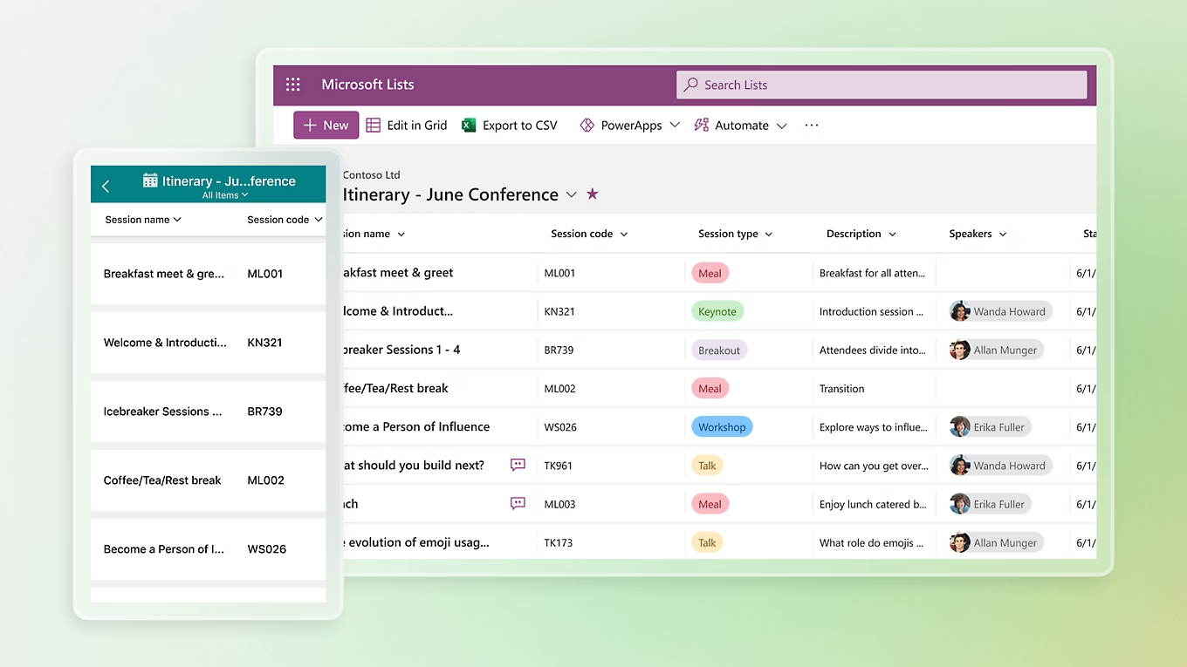
Introduction
What is Microsoft Lists
MS List is a tool for managing structured lists of data
Works like a simple table or database
Lets users:
Create lists
View data
Manage info clearly and easily

Slide 7

Key Functionalities of
Microsoft Lists

Slide 8
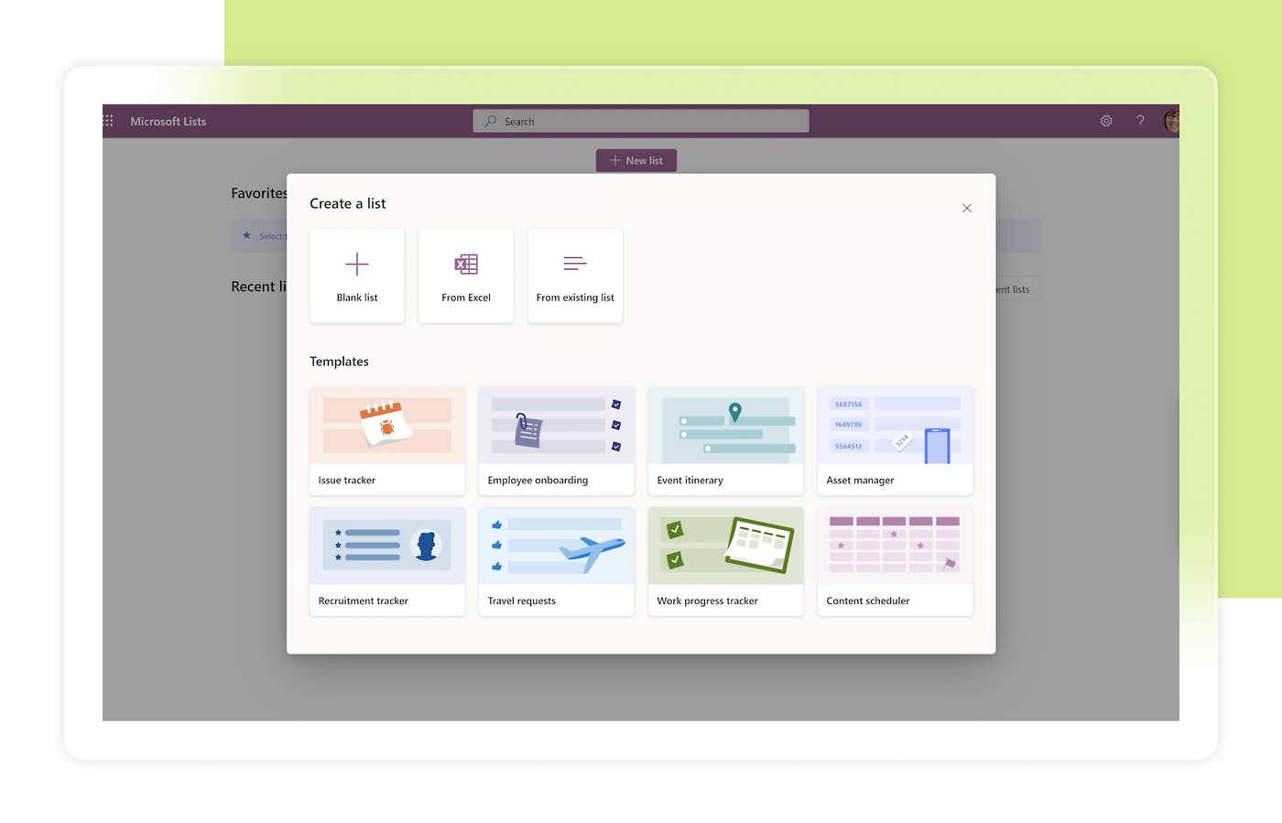
Key Functionalities
Create and Manage Lists
Custom Columns
Manage List Items
Custom Views
Conditional Formatting
Permissions and Sharing
Built-in Templates

Slide 9
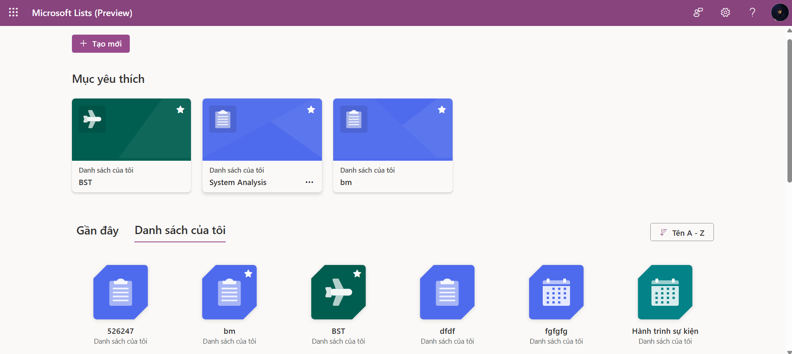

Dashboard Sreen
Account
FavoriteList
List
Icon
ListName
WorkspaceName
Notes:
Dashboard Screen Query
-- Get personal lists of user
SELECT
l.Id, l.Color, l.Icon, l.ListName, l.ListStatus, l.CreateBy, l.CreateAt
FROM
List AS l
INNER JOIN
Account AS acc ON l.CreateBy = acc.Id
WHERE
acc.Id = ?
ORDER BY
l.CreateAt ASC
-- Get favorite lists of user
SELECT
l.Id, l.Color, l.Icon, l.ListName, l.ListStatus, l.CreateBy, l.CreateAt
FROM
List AS l
INNER JOIN
Account AS acc ON l.CreateBy = acc.Id
WHERE
acc.Id = 3
ORDER BY
l.CreateAt ASC;
-- Get information of user
SELECT
acc.id, acc.Avatar, acc.FirstName, acc.LastName, acc.Company, acc.AccountStatus
FROM
Account AS acc
WHERE
acc.Id = ?

Slide 10
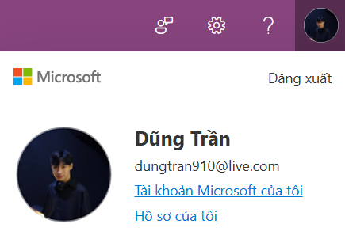


Dashboard Screen
FirstName
LastName
Avatar
Email
Notes:
Dashboard Screen Query
-- Get information of user
SELECT
acc.id, acc.Avatar, acc.FirstName, acc.LastName, acc.Company, acc.AccountStatus
FROM
Account AS acc
WHERE
acc.Id = ?

Slide 11
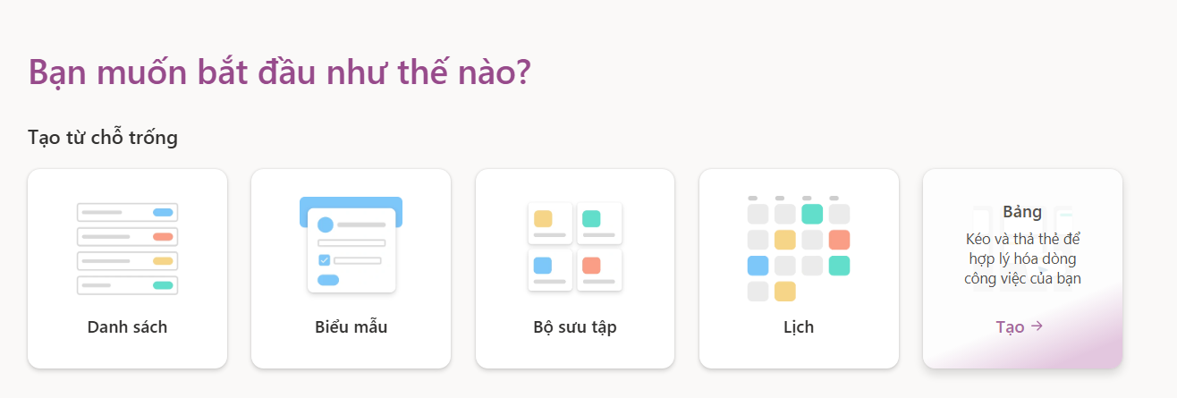
Create New List Screen
ListType
Icon
Description
Title
Notes:
Create New List Screen
-- Get all list types
SELECT
lt.Id, lt.Icon, lt.Title, lt.HeaderImage, lt.[Description]
FROM
ListType lt

Slide 12
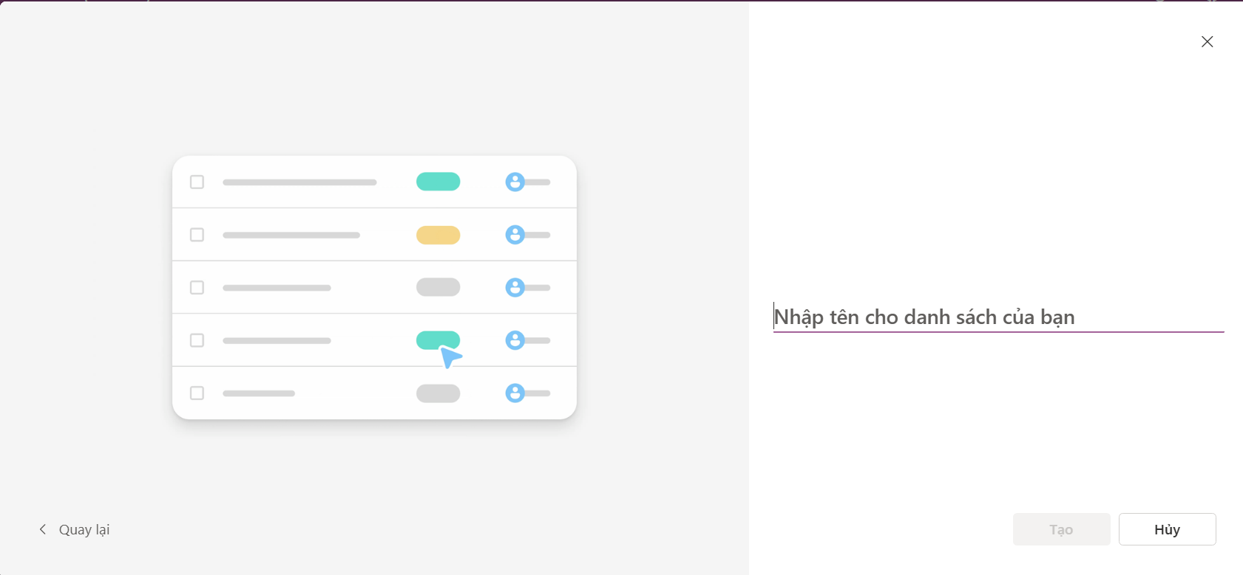
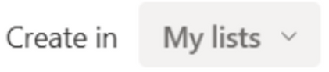
Create New List Screen
HeaderImage
Workspace
Notes:
Create New List Screen
-- Get all list types
SELECT
lt.Id, lt.Icon, lt.Title, lt.HeaderImage, lt.[Description]
FROM
ListType lt
-- Get all workspaces of user
SELECT *
FROM
w.Id, w.WorkspaceName
INNER JOIN
WorkspaceMember wm ON w.Id = wm.AccountId
ORDER BY
wm.Id DESC

Slide 13
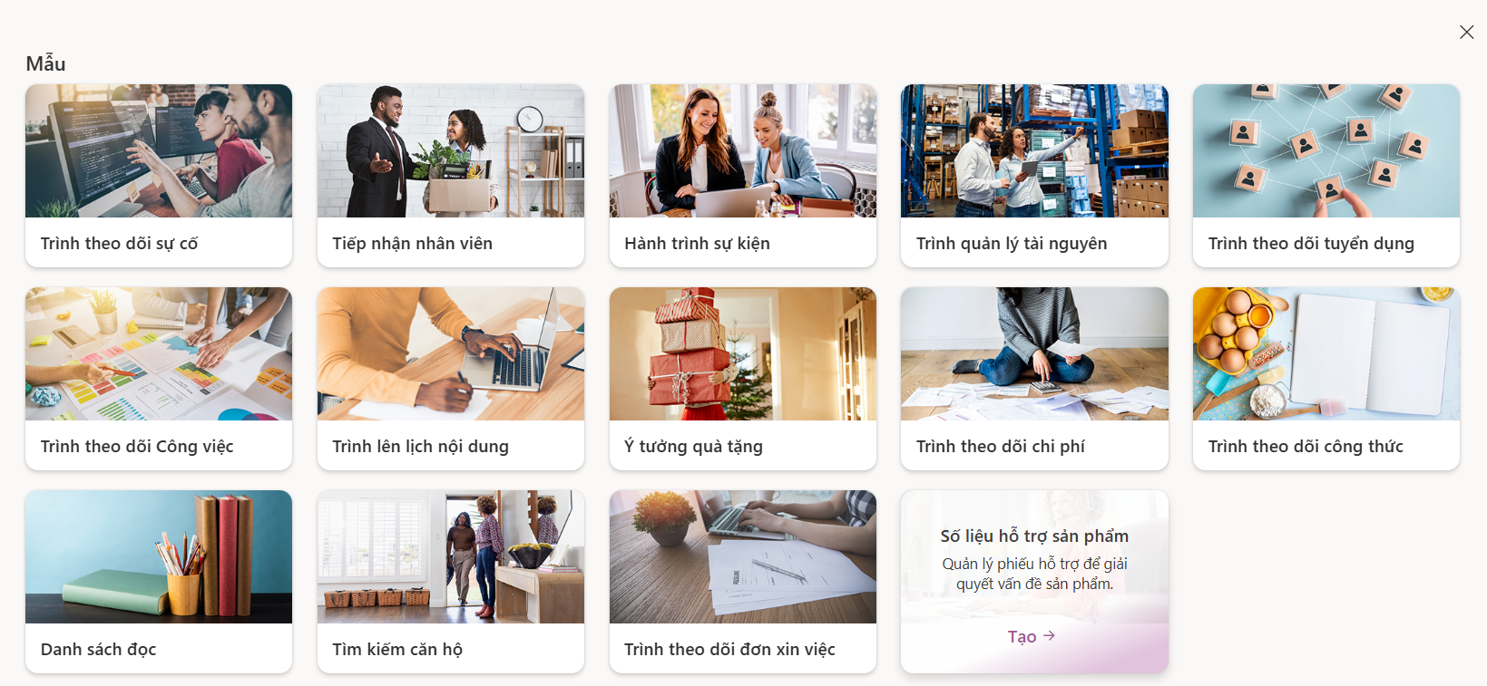
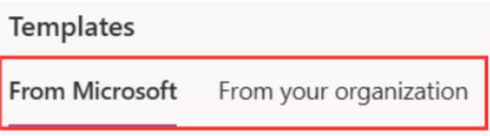

Create New List Screen
Provider
ListTemplate
HeaderImage
Title
Description
Notes:
Create New List Screen
-- Get all templates from
SELECT
*
FROM
ListTemplate

Slide 14
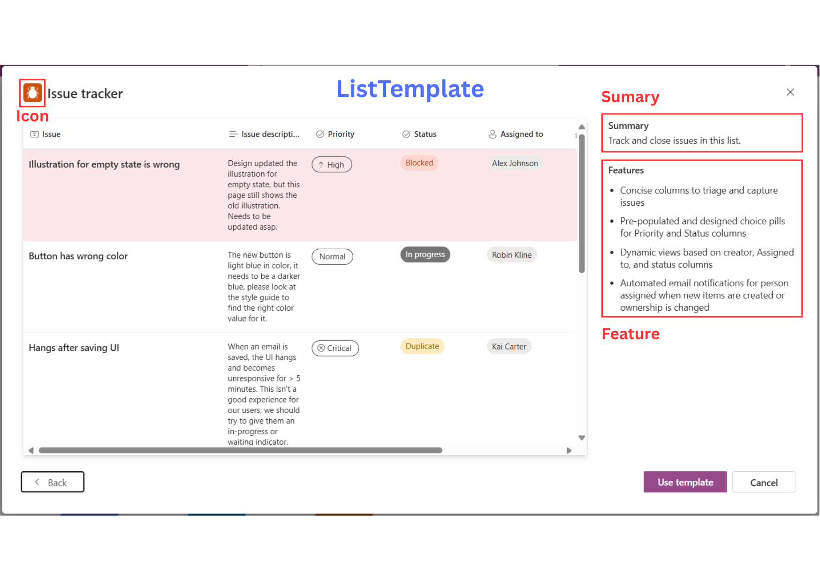
ListTemplate

Slide 15
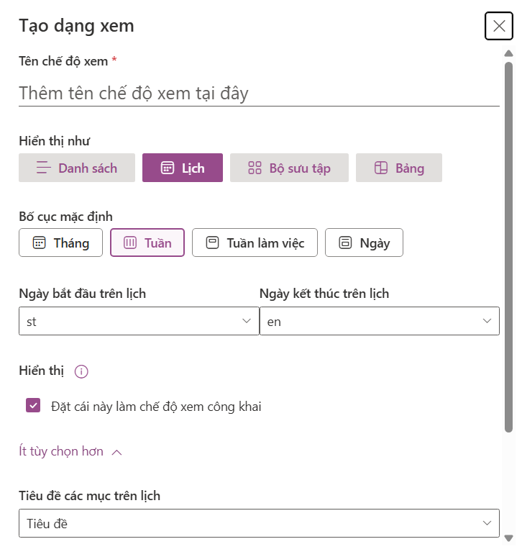
ViewTypeSetting
TemplateSampleRow
ViewType
ViewKeySetting

Slide 16
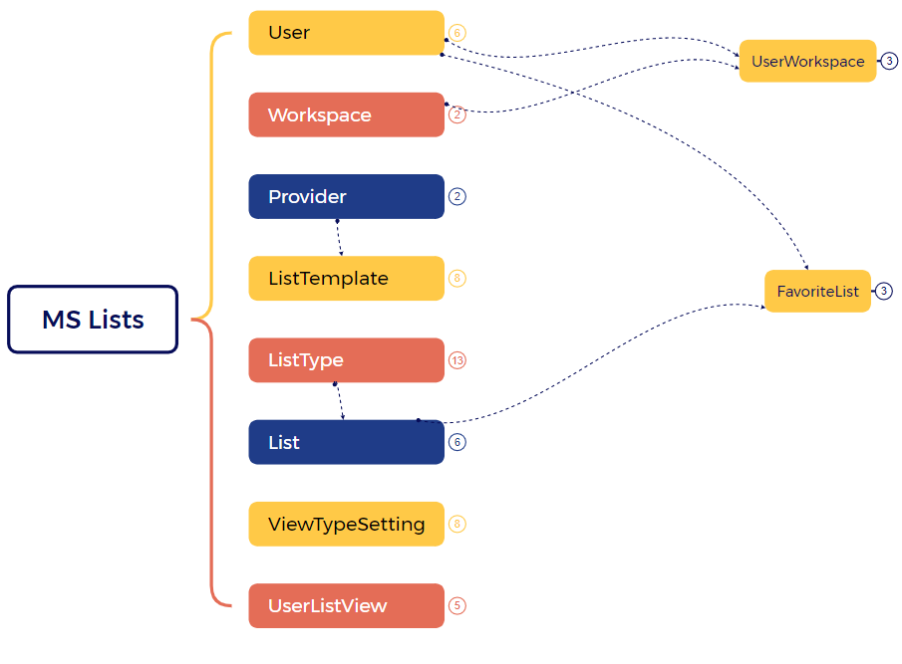
Mind Map Simplify for User, Template, List, View

Slide 17
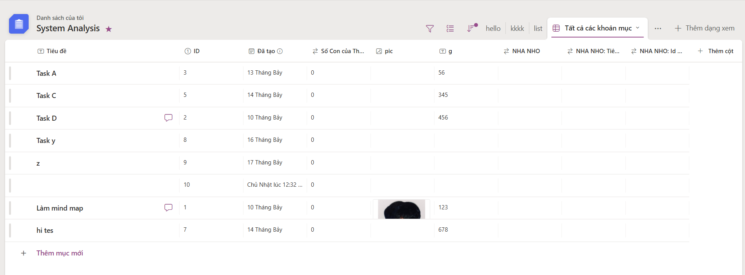
List Management
ListDynamicColumn
ListCellValue
ListRow

Slide 18
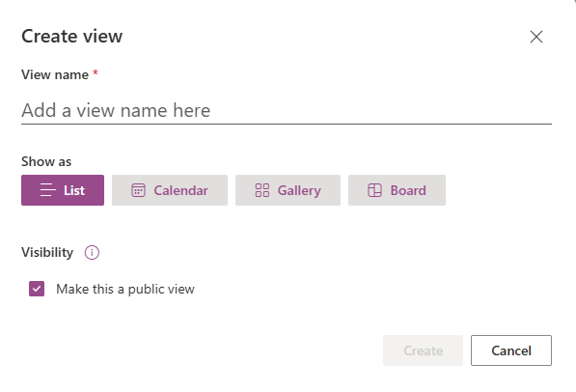
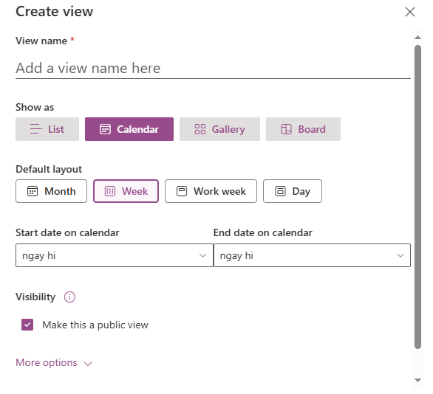
List Management

Slide 19
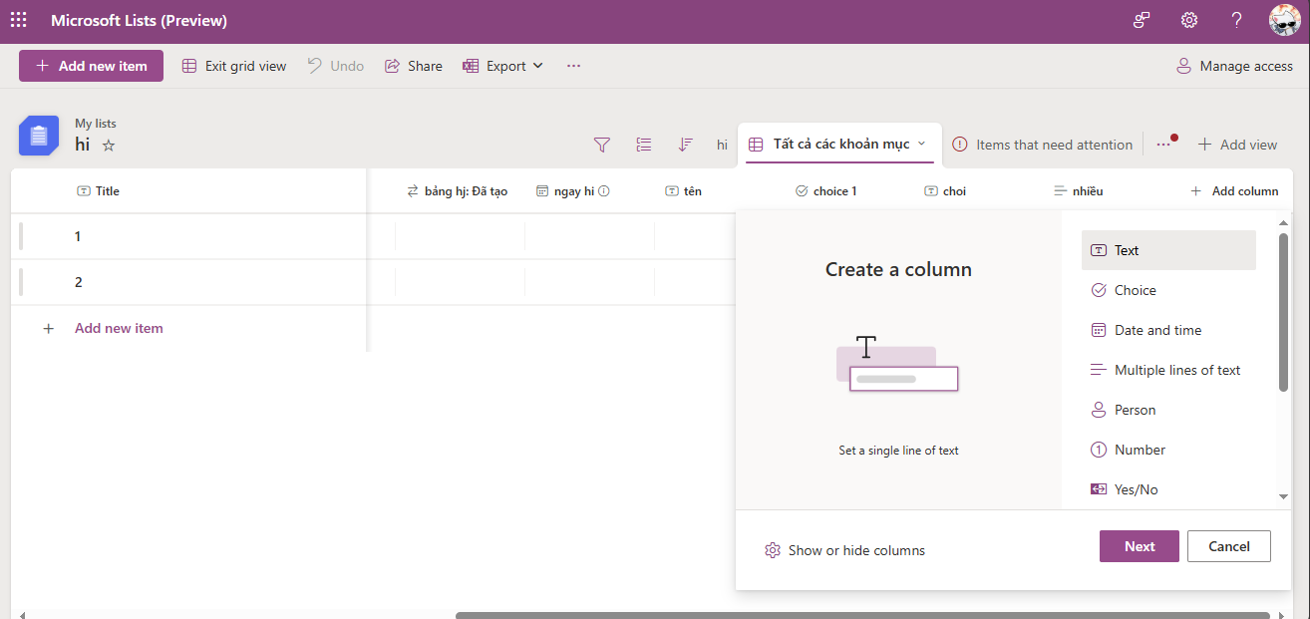
List Management

Slide 20
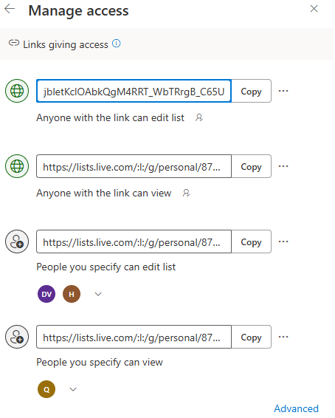
Manage Access

Slide 21
Example data

Slide 22
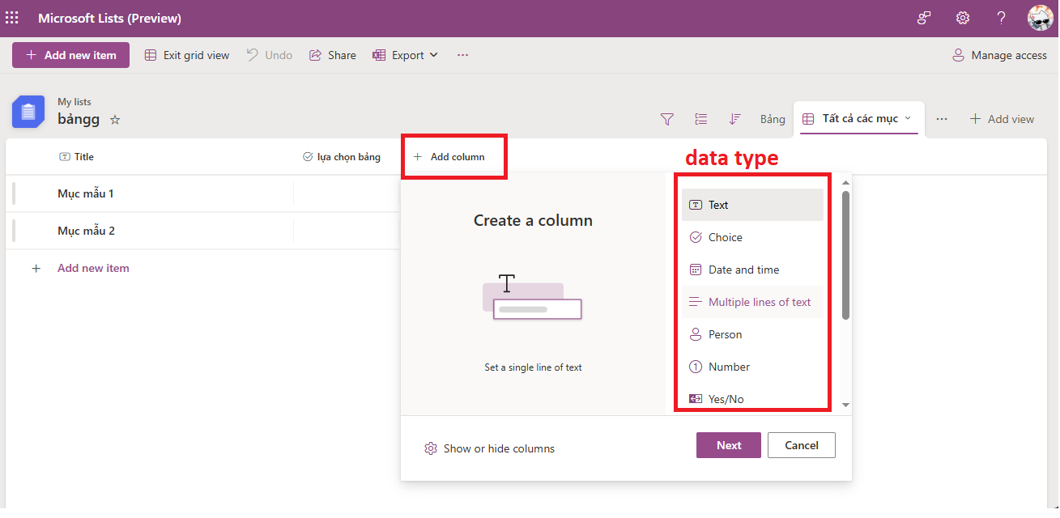
Example Data – Custom Columns

Slide 23
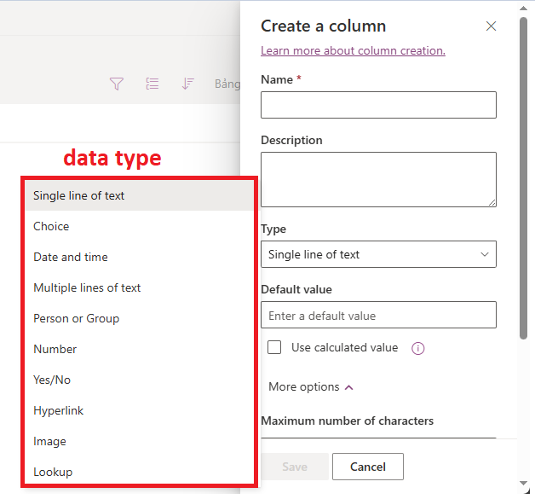
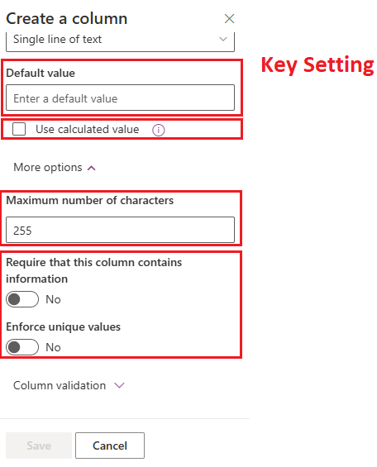
Example Data – Custom Columns

Slide 24
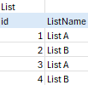
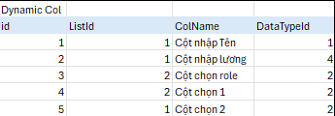
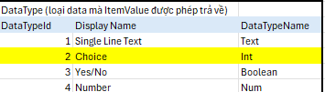
Example Data – Custom Columns

Slide 25
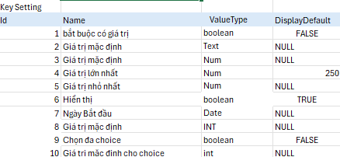
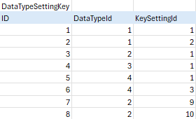
Example Data – Custom Columns

Slide 26
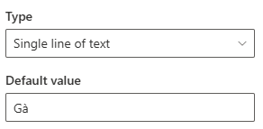
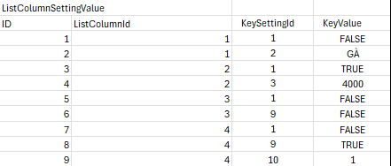
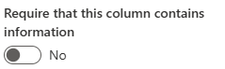
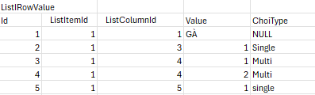
Example Data – Custom Columns

Slide 27
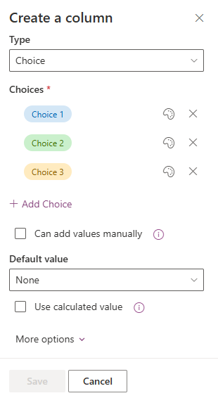
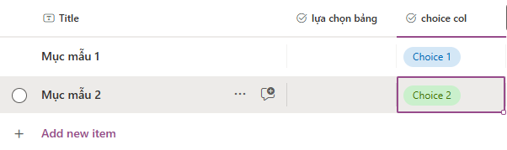
Example Data – Custom Columns

Slide 28
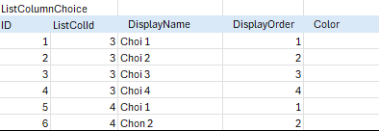
Example Data – Custom Columns

Slide 29
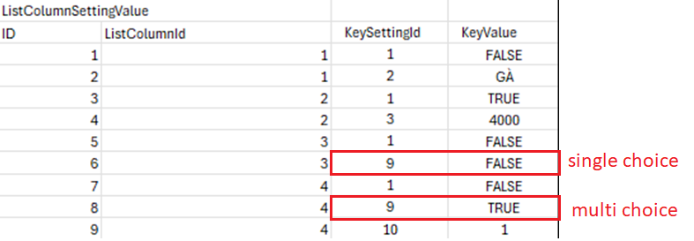
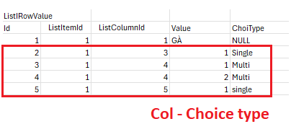
Example Data – Custom Columns

Slide 31
bbv template EN
Style guide

Slide 32
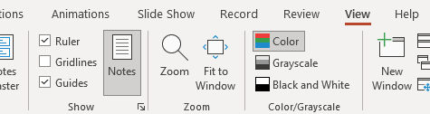

Working area, guides & ruler
Working area
Depending on the slide, a single-column layout, a 2-column or 3-column layout is used.
Display the ruler and guides in the «View» tab.

Slide 33
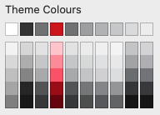
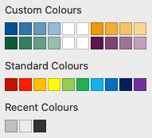
bbv colour theme
Always OK!
Never, please!
Default
text colours
Main
accent
Colours for diagrams,
charts, graphs etc.
Use selectively and sparingly
Never, please!
Colours for diagrams,
charts, graphs etc.
Colours for diagrams,
charts, graphs etc.

